Slide 1
LANGUAGE ENVELOPES
Bennett, Janet M. Based on an exercise developed by Jack Condon.

Slide 2
LANGUAGE ENVELOPES
Instructions
Divide into pairs.
Decide who is person A and who is person B.
Think in your first language.
Do the sorting in silence.
First A sorts the objects in the envelope, and B watches and guesses silently about the categories being used.
B reports observation and A reveals the categories used.
Then B sorts and A watches.
Repeat until facilitator stops the group.

Slide 3
DEBRIEF
How did you feel while sorting? While watching?
What categories did you come up with?
What did you learn?
What if we were the envelopes? How would we sort ourselves?
What if we…
Could have talked?
Sorted only once?

Slide 4
COLORS OF THE RAINBOW - 21 LANGUAGES
https://www.theguardian.com/education/2014/apr/29/what-vocabularies-tell-us-about-culture
Notes:
Humans have a tendency to sort. Even the words that we use to describe colors are a reflection of our tendency to sort.

Slide 5
COLORS OF THE RAINBOW – 8 LANGUAGES
https://www.theguardian.com/education/2014/apr/29/what-vocabularies-tell-us-about-culture
Notes:
Humans have a tendency to sort. Even the words that we use to describe colors are a reflection of our tendency to sort.

Slide 6
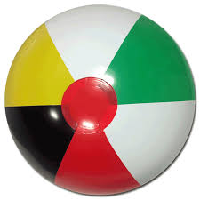
COLORS OF THE RAINBOW – 18 LANGUAGES
https://www.theguardian.com/education/2014/apr/29/what-vocabularies-tell-us-about-culture
Notes:
Humans have a tendency to sort. Even the words that we use to describe colors are a reflection of our tendency to sort.

Slide 7
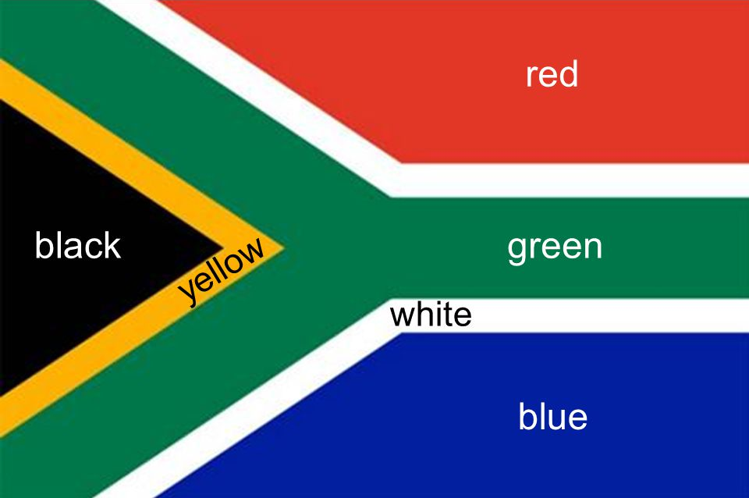
COLORS OF THE RAINBOW – 6 LANGUAGES
https://www.theguardian.com/education/2014/apr/29/what-vocabularies-tell-us-about-culture
Notes:
Humans have a tendency to sort. Even the words that we use to describe colors are a reflection of our tendency to sort.

Slide 8
LANGUAGE ENVELOPES
FRIEND
WHAT IS THE DEFINITION OF A FRIEND?
Notes:
What is your process for sorting friends? Someone you see in class? Someone you go to lunch with? Someone you call in the middle of the night or to whom you tell secrets?

